Slide 1


K.ROHITH 211114210
P.TEJOPAUL 211114237
Y.RAHUL 211114254
P.PAVAN 211114257
T.ARUN 211114277
Project Co-ordinator:
Dr. DHEERAJ K. AGARWAL

Slide 2

SONIC SENTINEL: IoT-Based Extreme Sound Alert System

Slide 3
contentS
Introduction
Working
KY-037
ESP-8266 and Blynk
Conclusion

Slide 4
INTRODUCTIOn
WHAT IS SOUND SENTINEL?
It is a device designed to monitor and analyze sounds in a given environment. This technology is often used for various purposes such as security, environmental monitoring .
The system operates in real-time, continuously scanning its surroundings for relevant sound patterns. When a predefined threshold or a specific sound event is detected, Sound Sentinel can trigger alerts, notifications, or automated responses, depending on the application.
General permissible level of sound level ranges from 40dB to 85dB based on the type of areas , security and environmental applications.

Slide 5
ARCHITECTURE
Microphones or Sensors: These are the primary input devices that capture sound signals from the environment. They may include microphones with different directionalities or specialized sensors designed to detect specific types of sounds.
Signal Processing Unit: This component processes the incoming audio signals to extract relevant information. It may involve filtering, amplification, and digital signal processing techniques to enhance the quality of the captured sounds and extract features for analysis.
Feature Extraction Module: This module analyzes the processed audio signals to extract relevant features that characterize different types of sounds. These features could include frequency content, temporal patterns, amplitude variations, and more.
Sound Classification Algorithm: Sound Sentinel utilizes machine learning algorithms or pattern recognition techniques to classify the extracted features into predefined categories or classes. These algorithms are trained on labeled datasets to accurately identify specific sound events of interest.

Slide 6
Thresholding and Event Detection: Once the sound is classified, a thresholding mechanism is applied to determine whether a detected sound event exceeds a predefined threshold. If the threshold is crossed, the system triggers an event detection mechanism to flag the occurrence of the sound event.
Alerting and Notification System: When a sound event of interest is detected, Sound Sentinel generates alerts or notifications to inform relevant stakeholders. This could involve triggering alarms, sending notifications to security personnel or authorities, or activating automated response systems.
User Interface: Sound Sentinel typically includes a user interface for configuration, monitoring, and visualization of the detected sound events. This interface may provide real-time feedback on the audio environment, display logs of detected events, and allow users to adjust system settings as needed.
Networking and Integration: Depending on the application, Sound Sentinel may be designed to integrate with existing security systems, environmental monitoring networks, or IoT platforms. This allows for seamless data sharing, interoperability, and remote management of the system.

Slide 7
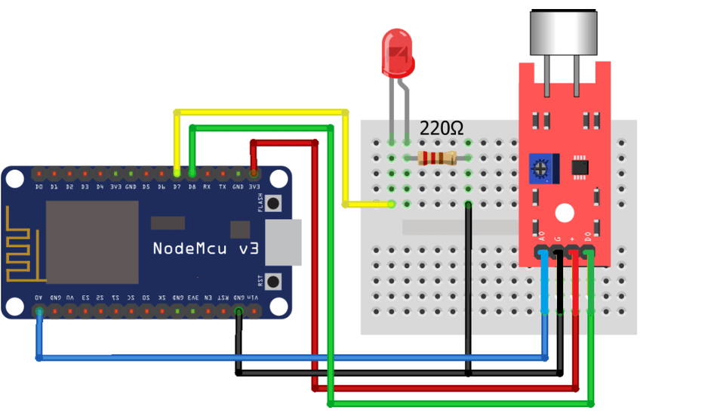
CIRCUIT DIAGRAM

Slide 8
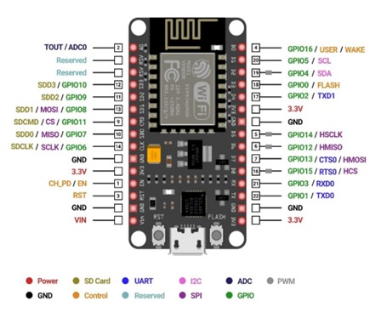
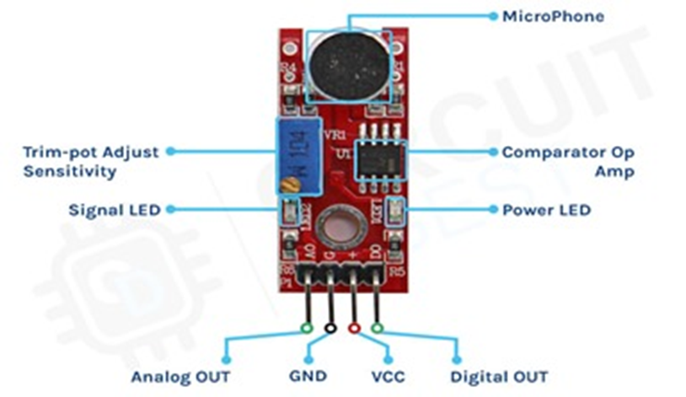
COMPONENTS
ESP-8266
KY-037

Slide 9
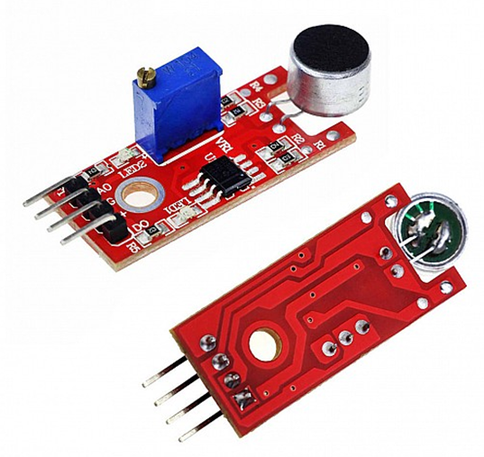
KY-037
The KY-037 high sensitivity sound detection module is an analog/digital sensor that uses a condenser microphone to observe changes in environment noise.
This module is compatible with popular microcontroller platforms like Arduino, ESP32, ESP8266, and Raspberry Pi.
The microphone picks up sound waves, which are then amplified and converted into an analog voltage signal proportional to the sound intensity.
The sensitivity of the sensor can often be adjusted using a potentiometer, allowing you to fine-tune its response to different levels of sound.

Slide 10
SPECIFICATIONS
This module has a CMA-6542PF electret condenser microphone, an LM393 differential comparator to control the digital output, a 3296W potentiometer to adjust the detection threshold, 6 resistors, 2 LEDs and 4 male header pins. The module features analog and digital outputs.
Operating Voltage: Usually operates within a range of 3.3V to 5V DC.
Detection Range: The effective range for sound detection can vary, but it typically covers a range of frequencies from around 50Hz to 20kHz.
The detection range of the KY-037 sound sensor module typically covers a range of sound intensities from around 40dB to 110dB.

Slide 11
ESP-8266
The ESP8266 is a low-cost Wi-Fi microchip with full TCP/IP stack and microcontroller capability. It's often used for Internet of Things (IoT) projects due to its low power consumption, small form factor, and ease of integration with other hardware components
Its Wi-Fi capabilities allow these devices to connect to the internet and interact with other devices or cloud services.
ESP8266-based devices can be used for home automation projects, enabling users to remotely control iot devices
Data collected by sensors can be transmitted wirelessly to a server or cloud platform for analysis.

Slide 12
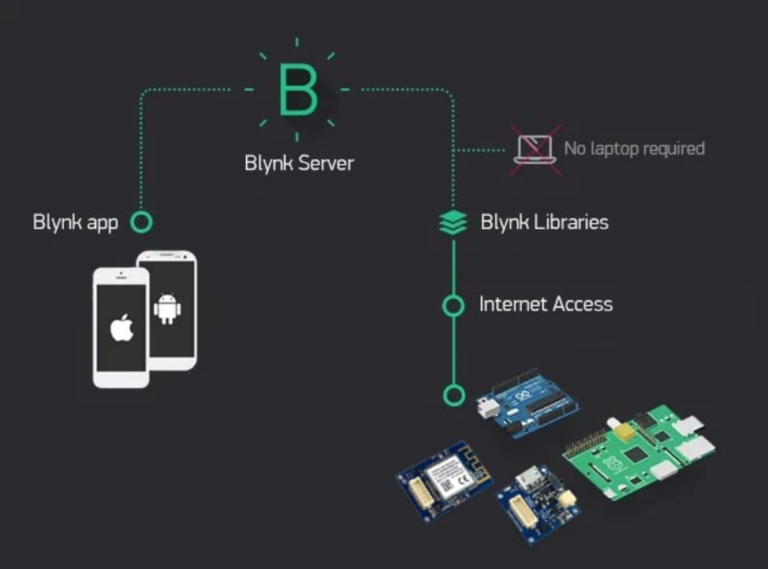
BLYNK APPLICATION
Blynk is a popular platform for building IoT applications without the need for extensive coding or hardware expertise. It provides a user-friendly interface for creating custom mobile apps to control and monitor IoT devices over the internet

Slide 13
Blynk's interface allows users to create custom mobile apps for controlling and monitoring IoT devices by simply dragging and dropping widgets such as buttons, sliders, graphs, and displays onto the app canvas.
Blynk provides cloud connectivity, allowing users to remotely control and monitor their IoT devices from anywhere with an internet connection
Blynk allows users to visualize real-time data from their IoT devices using graphs, gauges, and other visualization tools
This application supports push notifications, allowing users to receive alerts and notifications on their mobile devices based on predefined conditions or events

Slide 14
WORKING
ESP8266: A Wi-Fi enabled microcontroller that acts as the brain of the system. It is connected to a local WiFi network
KY-037 Sound Sensor: Detects sound levels and converts them into electrical signals.
Blynk Interface: A platform that allows you to build IoT applications for controlling and monitoring devices using smartphones.
The sound sensor detects sound waves and converts them into electrical signals.
The analog output of the sound sensor is read by the ESP8266.

Slide 15
It converts this analog value into a digital value that can be processed by the microcontroller.
We use mapping function to convert this value to decibels.
These values are continuously fed to Blynk server.
If the sound level exceeds 85dB, the ESP8266 sends an alert notification to the Blynk app.
Simultaneously, when the sound level exceeds the threshold, the ESP8266 also activates the LED connected to another digital pin.

Slide 16
REAL-LIFE APPLICATIONS
The sound sensor can be deployed in environmental monitoring systems to track noise pollution levels in urban areas, industrial sites, and residential neighborhoods.
In industrial settings, the sound sensor can be employed to monitor machinery and equipment for abnormal noise levels, providing early warnings of potential malfunctions or breakdowns.
Integrating sound sensors into smart city infrastructure enables city planners to monitor traffic noise, construction activities, and public events, facilitating better urban planning and management.

Slide 17

FUTURE ADVANCEMENT POSSIBILITIES
Multi-Sensor Integration: Incorporating additional sensors such as temperature, humidity, and air quality sensors can provide more comprehensive environmental monitoring capabilities.
Energy-Efficient Designs: Optimizing power consumption and implementing low-power modes can extend the system's battery life and enable long-term deployments in remote or off-grid location
Mobile Applications:* Developing mobile applications that allow users to remotely monitor sound levels, receive notifications, and control the system adds flexibility and convenience to the user experience.

Slide 18


